Slide 1
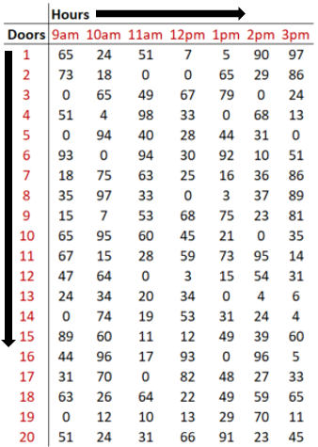
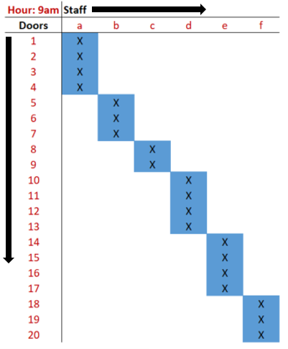



Distribute Overview
Input
Output
Allocation
Execution
Results
Distribute pulls in data from facility’s sorting system, showing upcoming volume levels across the facility.
Distribute creates a report for the manager containing the optimal assignment of their team to areas of the facility.*
Managers inform their team of the new assignments.
Team members work their assigned area until the next assignment.
Facility performance improves, leading to lower costs and higher workforce utilization
*areas may constitute sets of doors, lanes, bays, etc.

Slide 2
Ideal Distribute customer
Distribute is most valuable for facilities that generally meet the following criteria:
Need for Improvement
There is a need to significantly improve the allocation of scarce resources, because the current approach is not yielding expected results. For some facilities this may mean:
Productivity metrics are suffering or inconsistent
Productivity metrics are not being tracked and management is seeking a solution
Employees are experiencing a constant tug-of-war for their time
Decision Complexity
Managers needs to make complex resource allocation decisions very quickly with several, sometimes thousands, of available options. Factors that affect the complexity of the decision process include:
Size of the workforce
Size of the facility
Volume processed by the facility in a typical day
Level of volatility in volume throughout the facility over time
Data Quality
The volume that will be routed to a particular area of the facility is either known before resource allocation decisions need to be made, or can at least be modeled/predicted accurately. If neither is possible, Distribute can be used as a benchmarking tool, comparing actual performance to a more realistic ideal state.

Slide 3
Other “In the Box” Optimization Applications
While SDA is designed to optimize decisions in outbound operations, there are several other applications related to elements occurring earlier in the distribution process
Process | Application | Key Decision
Inbound | Truck-to-Door Sequencing | How should I sequence the assignment of delivery trucks to inbound doors to avoid causing congestion as soon as new cartons are inducted into the system?
 | Staff-to-Door Allocation | What is the best assignment of staff to doors that enables my staff to be as productive as possible?
Warehousing | Staff-to-Aisle Allocation | What is the best assignment of staff to warehouse aisles that enables my staff to be as productive as possible?
 | Throughput Benchmarking | What is the most volume I can reasonably process through the facility in a day?
Outbound | Door-to-Store Re-Mapping | What is the best “map” or door-to-store configuration of outbound that minimizes congestion/need to re-allocate staff?
 | Staff-to-Door Allocation | What is the best assignment of staff to doors that enables my staff to be as productive as possible?

Slide 4
Other tools we plan to develop
 | Description | Potential Customer
1 | Develop a tool to allocate staff to projects/tasks based on time & skill demand/availability in a way that minimizes over and understaffing. | Internal CALIBRE projects Other project-based organizations
2 | Develop a tool to plan production/logistics requirements over time in a way that meets demand while abiding by raw material availability and capacity constraints while minimizing total cost throughout the network. | DLA Army depots
3 | Develop a tool to recommend the appropriate workforce size and composition to meet changing business requirements while minimizing costs or employee turnover. | Various organizations across the government considering a strategic reorganization
4 | Develop a tool to decide which locations to keep open and which to close to maintain current customer access levels while minimizing cost. | FCC spectrum auctions Geographically dispersed service organizations
5 | Develop a tool to identify which links in a network to focus on when deciding where to build additional capacity. | IT organizations Transportation networks

